Slide 1
Improving irrigation data for pest modelling using Earth observation data and techniques
Tim Beale (CABI), Gerado Lopez Saldana (Assimila),
Darren Kriticos (Cervantes Agritech), Bryony Taylor (CABI)
International Pest Risk Research Group (IPRRG) Annual Meeting 2022, Athens, 10/10/2022
https://ckan.cabi.org/data/dataset/improving-irrigation-data-using-eo

Slide 2
Intro
Project:
EO4AgroClimate
Partners:
CABI
Assimila
Cervantes
Aim:
Improve and test novel irrigation datasets developed using EO data which may help identify actively irrigated areas and therefore improve pest models under changing irrigation scenarios
Notes:
Tim Beale – Data Analyst from CABI
Project:
The UK's Science & Technology Facilities Council (STFC) – aiming to establish a bilateral UK/Australia AgroClimate Space Programme (EO4AgroClimate).
Aim: Satellite remote sensing data, technology and modelling capabilities to enable farming in both countries to become climate resilient while supporting the UK commitment to cut emissions
Short term - prototype program
Partners:
CABI – International not-for- profit organisation – providing information and applying scientific expertise to tackle agricultural and environmental problems
Assimila – Earth Observation experts – systems and tools for turning EO data into applications
Cervantes – Darren’s company - Pest modelling expert - Australian Partner
Aim:
3 months to investigate irrigation datasets and test new methods

Slide 3
Irrigation in pest modelling
Pest model a:
Suitable area under
natural scenario
Irrigated area
Pest model b:
Suitable area under
irrigation scenario
Pest model: Composite suitability map
Yonow, T., Kriticos, D.J., Ota, N. et al. The potential global distribution of Chilo partellus, including consideration of irrigation and cropping patterns. J Pest Sci 90, 459–477 (2017). https://doi.org/10.1007/s10340-016-0801-4
Notes:
Current state of play in pest modelling

Slide 4
Irrigation in pest modelling
Pest model a:
Suitable area under
natural scenario
Irrigated area
Pest model b:
Suitable area under
irrigation scenario
Pest model: Composite suitability map
Yonow, T., Kriticos, D.J., Ota, N. et al. The potential global distribution of Chilo partellus, including consideration of irrigation and cropping patterns. J Pest Sci 90, 459–477 (2017). https://doi.org/10.1007/s10340-016-0801-4
Notes:
Irrigated areas constitute 40 % of the total area used for agricultural production (FAO, 2014a)

Slide 5
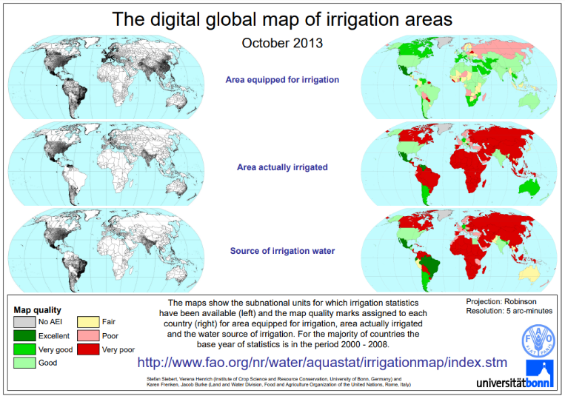
Global Map of Irrigated Areas (GMIA)
Latest version (v5) 2013
Areas equipped for irrigation around the year 2005
Resolution 5 arc mins (~10km)
Stefan Siebert, Verena Henrich, Karen Frenken and Jacob Burke (2013). Global Map of Irrigation Areas version 5. Rheinische Friedrich-Wilhelms-University, Bonn, Germany / Food and Agriculture Organization of the United Nations, Rome, Italy
Notes:
For global species distribution models – most commonly used dataset is the GMIA - Global Map of Irrigated Areas
Taking a closer look at the dataset we can understand the challenges of monitoring irrigation
Version 5 – 2013
Irrigation “around the year 2005” (17 years ago)
Resolution = 5 arc minutes

Slide 6
Global Map of Irrigated Areas (GMIA)
Latest version (v5) 2013
Areas equipped for irrigation around the year 2005
Resolution 5 arc mins (~10km)
Stefan Siebert, Verena Henrich, Karen Frenken and Jacob Burke (2013). Global Map of Irrigation Areas version 5. Rheinische Friedrich-Wilhelms-University, Bonn, Germany / Food and Agriculture Organization of the United Nations, Rome, Italy
Notes:
Area Equipped for Irrigation
Information on irrigated areas and activities is collected through national statistical offices. In some cases this is combined with remote sensed data. However this data is collected at different reporting levels and is slow to collate, harmonise and goes out of date quickly.
Data for areas equipped for irrigation is estimated to have a quality of quite good (top ‘green’ map)

Slide 7
Global Map of Irrigated Areas (GMIA)
Latest version (v5) 2013
Areas equipped for irrigation around the year 2005
Resolution 5 arc mins (~10km)
Stefan Siebert, Verena Henrich, Karen Frenken and Jacob Burke (2013). Global Map of Irrigation Areas version 5. Rheinische Friedrich-Wilhelms-University, Bonn, Germany / Food and Agriculture Organization of the United Nations, Rome, Italy
Notes:
Area Actually Irrigated
Due to several reasons (e.g. crop rotation, water shortages, and damage of infrastructure) the area actually irrigated maybe significantly lower than the area equipped for irrigation
Some countries only report the area actually irrigated – so it is then assumed that this is the equipped area.

Slide 8
Global Map of Irrigated Areas (GMIA)
Latest version (v5) 2013
Areas equipped for irrigation around the year 2005
Resolution 5 arc mins (~10km)
Australia - Area actually irrigated was 2,546,318 ha in season 2005/2006 but declined to 1,760,758 ha in season 2008/2009 due to drought
Stefan Siebert, Verena Henrich, Karen Frenken and Jacob Burke (2013). Global Map of Irrigation Areas version 5. Rheinische Friedrich-Wilhelms-University, Bonn, Germany / Food and Agriculture Organization of the United Nations, Rome, Italy
Notes:
Australia
Area equipped – not reported
- Calculated by area actually irrigated and RS data
Irrigation volumes applied – data from surveys
Australian land use map – irrigation assigned to crop areas
MODIS land cover data - irrigation assigned to cropland
Area actually irrigated
- GMIA used a value from 2005/6 season as this was a maximum for within the period of 2002-10 (2.5million hectares)
2008/9 – Area irrigated was ~30% smaller – severe droughts
Summary
Large fluctuations in irrigation patterns
Data is slow to collect and process – even in countries with ‘good’ data
In data poor countries, assumptions are made based on landcover maps and crop types
GMIA does a good job of harmonising many different sources of data and delivering a global map, however it has its problems.
Poor irrigation data can lead to large over or underestimations in whether an areas can sustain a particular pest

Slide 9
EO Approach
Area: Murray-Darling Basin, Australia
Identify cropland using Enhanced Vegetation Indices (EVI)
MODIS Vegetation Indices
Terra Moderate Resolution Imaging Spectroradiometer (MOD13A2) Version 6.1, 1km spatial resolution, 16 day temporal resolution. From 2002 - 2022
Compare with environmental variables
ECMWF – ERA5 temperature and precipitation
The European Centre for Medium-Range Weather Forecasts, reanalysis datasets version 5 (ERA5), 30km spatial resolution, hourly temporal resolution
Notes:
Murray-Darling Basin - This area has a broad climatic range, a wide variety of land uses and land cover types, irrigation patterns and both irrigated and non-irrigated agriculture and horticulture
EVI is more sensitive to high biomass areas (like agricultural crops) capable of discriminating vegetation differences in sparse and dense vegetation areas, it is a good choice for monitoring irrigated areas where the canopy can be denser than in rain-fed agriculture.
Step 1
MODIS data processed – 16 days - QA processes to remove any low quality pixels and interpolate across any gaps
Result – Crop areas at 1km resolution
Step 2
We obtained 2m air temperature, total precipitation data for the whole Australia mainland and aggregated it to monthly daily maximum, mean and minimum values.

Slide 10
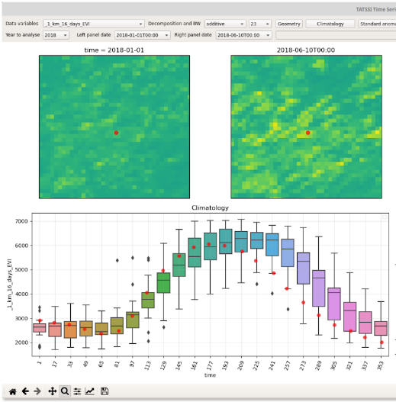
Vegetation
Unimodal - rainfed agricultural area
Bimodal - irrigated agricultural area
Notes:
Left – Typical rainfed agricultural area
Example pixel - Jan 1st 2018 - Green = Low vegetation
June 10th 2018 - Yellow = High vegetation
Boxplots show the vegetation index in the 16-day time steps across the 20 years (2002 – 2022)
Right – Typical pattern for an irrigated pixel with 2 vegetation peaks (2016)

Slide 11
Vegetation
Unimodal pattern 2017 – 2019
Related to drought?
Bimodal example (2016)
Notes:
Expand example 2 out to view the whole 20 year time series
This graph suggests that this pixel has not been under the same practices for the whole timeframe. Some years unimodal (or no 2019) vegetation is observed.

Slide 12
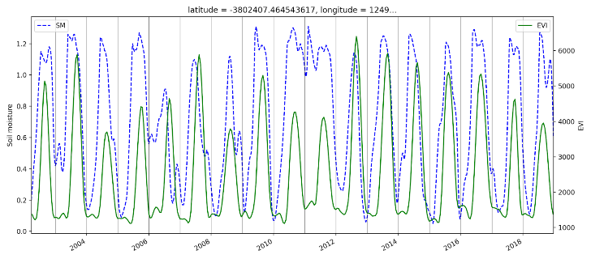
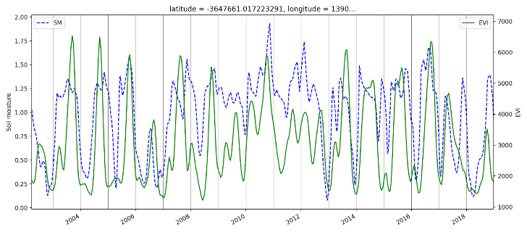
Comparison with climate data
ERA5 data was used to populate the CLIMEX soil moisture model (blue) and compared with the EVI vegetation model (green)
EVI identified rainfed cropland (in 2010) →
EVI identified irrigated cropland (in 2010) →
Notes:
Selected 2 locations based on 2010 vegetation conditions
Top graph - shows the unimodal rainfed pattern (matching quite well) consistent year to year.
The bottom graph – more of a mixed picture but in 2009 and 2010 with 2 peaks of vegetation. The soil moisture stayed fairly stable but peaked in the second half of the year as expected

Slide 13
Comparison with climate data
ERA5 data was used to populate the CLIMEX soil moisture model (blue) and compared with the EVI vegetation model (green)
EVI identified rainfed cropland (in 2010) →
EVI identified irrigated cropland (in 2010) →
Notes:
Selected 2 locations based on 2010 vegetation conditions
Top graph - shows the unimodal rainfed pattern (matching quite well) consistent year to year.
The bottom graph – more of a mixed picture but in 2009 and 2010 with 2 peaks of vegetation. The soil moisture stayed fairly stable but peaked in the second half of the year as expected

Slide 14
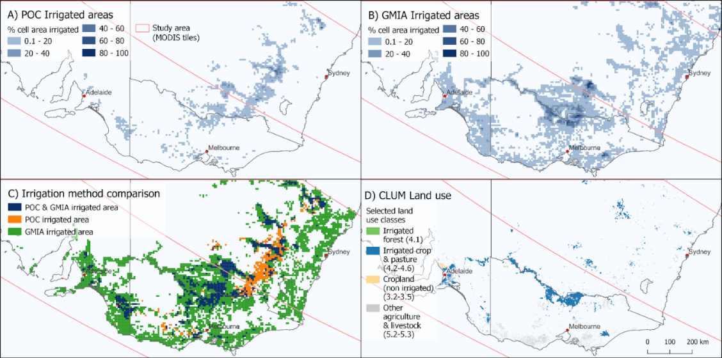
Results: Irrigation
Notes:
- A) POC irrigated areas – 20 year averages
- B) GMIA. Quantities are known to represent a maximum water use period (2005/6 season) and the distribution is based on remote sensed data from 2001-2
- C) Comparison
- D) Catchment scale land use data for Australia (CLUM) (2020) There is good correlation between major irrigated areas with the POC. Although some locations appear to be underestimated like the Sunraysia fruit growing region in North West Victoria.

Slide 15
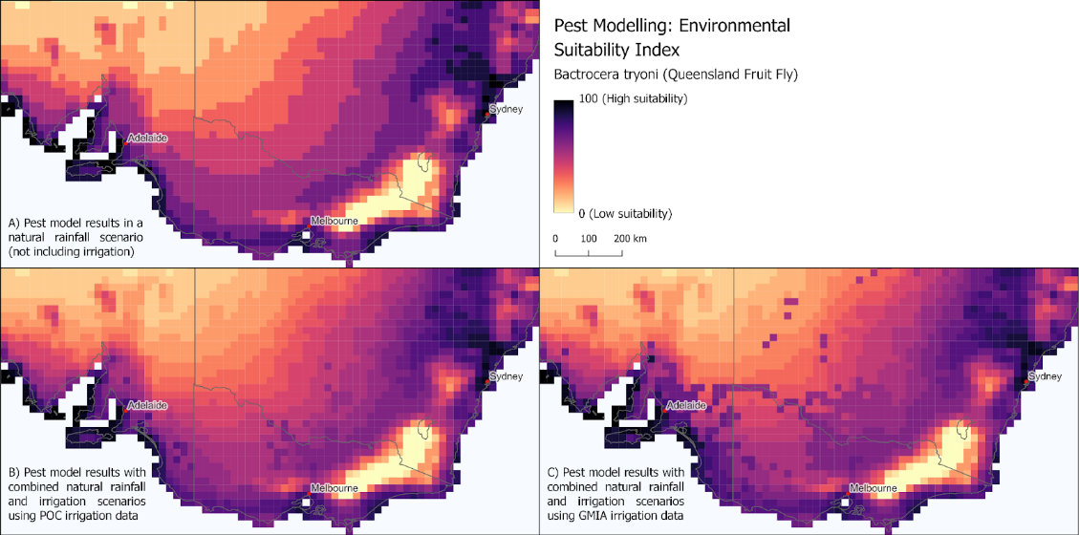
Results: Irrigation & Pest Modelling
Notes:
Demonstration of the model – Queensland fruit fly
Area very suitable for the fruit fly naturally (A)
(B) Rainfed with POC irrigation dataset
- (C) GMIA – Overestimation?
In areas of naturally low environmental suitability, being able to accurately identify external environmental factors, like irrigation patterns is crucial to understanding the potential distribution of agricultural pests.

Slide 16
Summary
Year | Global irrigated area (million hectares)
1961 | 139
2009 | 301
2050 | 337
(FAO, 2011a), (Alesandratos and Bruinsma, 2012).
EO Studies:
Global Irrigated Area Map (GIAM) (Thenkabail et al, 2009)
Identified 43% more irrigated areas than reported in official FAO statistics
A study published in 2018 using SPOT data (1999-2012) found big differences EO vs reported irrigation:
“The results globally show a 18 % larger irrigated area than existing approaches based on statistical data” (Meier, Zabel & Mauser, 2018)
Notes:
Climate change
Irrigated area more than doubled between 1961 and 2009
But estimated to slow to a rate of increase of less than 0.1% per year
EO Solutions:
Show that stats approach has weaknesses
Challenge - No perfect ground truthing data
With a more rapidly changing climate its going to be hard to predict how different agricultural regions are going change practices and respond.
EO has potential to provide us with better data, more timely – in turn will allow us to more accurately model pest distributions under changing climate scenarios
For example, sanitary and phytosanitary (SPS) organisations may want to understand irrigation patterns for the previous year or season to understand locations at risk of particular pests and diseases and to guide survey and monitoring activities.
Our POC showed potential to identify areas affected by wildfire. EO derived vegetation indices over time clearly show areas which have a consistent pattern of either natural vegetation or agricultural growth and then contracting periods of vegetation absence. Whilst other systems exist to predict and monitor wildfire risk, this POC may have potential to monitor the longer term impacts of wildfire on land use and habitats for pests and diseases

Slide 17
Next steps
How do you factor irrigation into your pest modelling work?
- What datasets do you use?
What would the ‘ideal’ irrigation dataset look like for pest modelling?
Equipped for or Actual?
Long or short term averages?
Min / Max irrigation scenarios?
Probability of irrigation?
Will we be able to forecast irrigated areas…?

Slide 18
Links & References
This presentation: https://doi.org/10.34857/0034092
https://ckan.cabi.org/data/dataset/improving-irrigation-data-using-eo
Alexandratos, N., and Bruinsma, J, World agriculture towards 2030/2050: The 2012 revision. Food and Agriculture Organization (FAO). ESA Working Paper No. 12-03, Rome, 2012.
Meier, J., Zabel, F., and Mauser, W.: A global approach to estimate irrigated areas – a comparison between different data and statistics, Hydrol. Earth Syst. Sci., 22, 1119–1133, https://doi.org/10.5194/hess-22-1119-2018,2018.
FAO – Food and Agriculture Organization of the United Nations: Did you know …? Facts and figures about, http://www.fao.org/nr/water/aquastat/didyouknow/index3.stm (last access: 24 November 2016), 2014a.
FAO. 2011a. The state of the world’s land and water resources for food and agriculture (SOLAW) – managing systems at risk. Rome, FAO and London, Earthscan.
Siebert S, Döll P, Hoogeveen J, Faures J-M, Frenken K, Feick S (2005) Development and validation of the global map of irrigation areas. Hydrol Earth Syst Sci Disc 2:1299–1327
Prasad S. Thenkabail, Chandrashekhar M. Biradar, Praveen Noojipady, Venkateswarlu Dheeravath, Yuanjie Li, Manohar Velpuri, Muralikrishna Gumma, Obi Reddy P. Gangalakunta, Hugh Turral, Xueliang Cai, Jagath Vithanage, Mitchell A. Schull & Rishiraj Dutta (2009) Global irrigated area map (GIAM), derived from remote sensing, for the end of the last millennium, International Journal of Remote Sensing, 30:14, 3679-3733, DOI: https://doi.org/10.1080/01431160802698919
Yonow, T., Kriticos, D.J., Ota, N. et al. The potential global distribution of Chilo partellus, including consideration of irrigation and cropping patterns. J Pest Sci 90, 459–477 (2017). https://doi.org/10.1007/s10340-016-0801-4
Notes:
This will allow us to more accurately model pest distributions under changing climate scenarios
Other potential applications
In addition to a long-term average irrigated land product, irrigation layers for different time periods could be developed depending on the application. For example, sanitary and phytosanitary (SPS) organisations may want to understand irrigation patterns for the previous year or season to understand locations at risk of particular pests and diseases and to guide survey and monitoring activities.
Our POC showed potential to identify areas affected by wildfire. EO derived vegetation indices over time clearly show areas which have a consistent pattern of either natural vegetation or agricultural growth and then contracting periods of vegetation absence. Whilst other systems exist to predict and monitor wildfire risk, this POC may have potential to monitor the longer term impacts of wildfire on land use and habitats for pests and diseases

